Slide 1
Module 3
Exploring Compute Services

Slide 2
Outline
1. MODULE 3 INTRODUCTION
  Introduction to Serverless Computing
2. AWS SERVERLESS, CONTAINERS, AND SOLUTIONS OVERVIEW
  AWS Lambda
  Containers and Orchestration on AWS
  Additional Compute Services

Slide 3
With serverless computing, you run applications without managing the underlying infrastructure.
In the following lessons, you learn how to take full advantage of it with powerful compute services.
You explore AWS Lambda, a serverless solution that automatically handles scaling, availability, and maintenance.
You also discover services like Amazon Elastic Container Service (Amazon ECS), Amazon Elastic Kubernetes Service (Amazon EKS), and AWS Elastic Beanstalk, which make container management and application deployment more manageable.
After completing these lessons, you will be ready to choose the best one for your needs.

Slide 4
Introduction to Serverless Computing

Slide 5
In this lesson, you will learn:
Describe the differences between unmanaged, managed, and serverless compute services in AWS.
Describe the customer and AWS responsibilities regarding serverless computing.

Slide 6
Quick Recap: EC2
Amazon EC2 (Elastic Compute Cloud) provides virtual machines (instances) in the AWS Cloud.
Suitable for a wide range of workloads: from basic web servers to high-performance computing.
Unmanaged service: You manage operating systems, patching, scaling, and configurations.
Operates under the Shared Responsibility Model:
  AWS: Security of the cloud (infrastructure).
  You: Security in the cloud (OS, apps, data, access control, etc.

Slide 7
Managed vs. Unmanaged Services
With unmanaged compute services like Amazon EC2, AWS takes care of the underlying physical infrastructure, but you're responsible for setting up, securing, and maintaining the operating system, network configurations, and applications on your instances.
Managed services, on the other hand, reduce the amount of infrastructure you need to manage. While AWS handles much of the operational overhead, you might still need to perform some provisioning or configuration depending on the service.

Slide 8
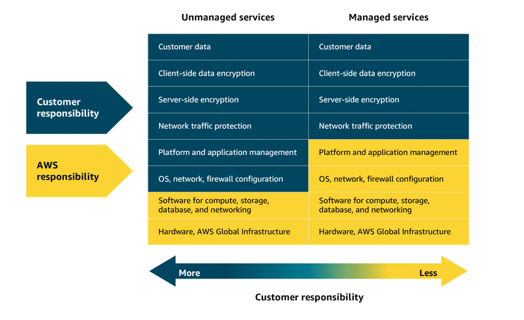

Slide 9
Fully-managed services
Fully-managed services—like serverless ones—take abstraction even further, eliminating the need to provision or manage any servers at all.
The underlying infrastructure is fully managed by AWS, so you can focus entirely on writing and deploying code.
Later in this module, you will explore Lambda.
Lambda is a serverless compute service where AWS handles the infrastructure, scaling, and availability, while you remain responsible for securing and managing your application code.

Slide 10
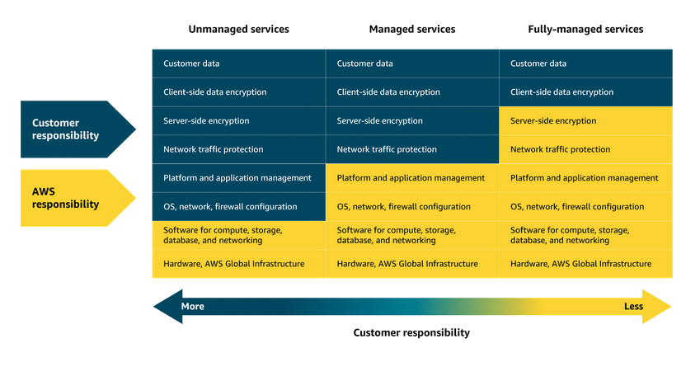

Slide 11
AWS Lambda

Slide 12
In this lesson, you will learn:
Recall what Lambda is and its core functionality as a serverless compute service.
Identify the key components of Lambda, such as triggers, functions, and scaling.
learn about AWS Lambda, a serverless compute service that runs code without managing servers.

Slide 13
Lambda
Lambda is a serverless compute service that runs code in response to events without the need to provision or manage servers.
It automatically manages the underlying infrastructure, scaling resources based on the volume of requests.
You are charged only for the compute time consumed, down to the millisecond.
Lambda handles execution, scaling, and resource allocation.
You can optimize performance by configuring the appropriate memory size for your function.

Slide 14
About Lambda
Lambda represents the Function as a Service (FaaS) model. You upload a function (code), set a trigger, and it runs only when needed.
AWS handles infrastructure, scaling, patching, and availability. You just focus on writing the function code.
Lambda automatically scales to meet demand. 1 request or 1,000? Lambda handles it.
Max execution time is 15 minutes per function invocation.
Built-in: Python, JavaScript (Node.js), Java, Go, C#, Ruby, etc. You can also bring your custom runtime.

Slide 15
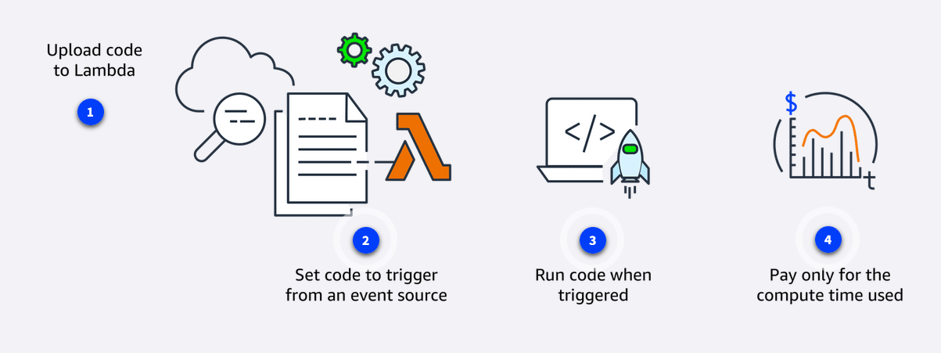
How Lambda works

Slide 16
How Lambda works
1. Upload code to Lambda
  First, upload the code to Lambda, which uploads as a Lambda function.
2. Set code to trigger from an event source
  Next, configure your code to be triggered by events, like AWS services, mobile apps, or HTTP requests.
3. Run code when triggered
  Your code runs only when an event occurs, like a file upload or user action.
  Lambda automatically handles all the server management, scaling, and infrastructure.
  The Lambda runtime executes your function code using the event data passed to it.
  This way, your code runs reliably, securely, and efficiently—without you managing the servers or environment it runs in.
4. Pay only for the compute time used
  You are charged only for the compute time consumed, down to the millisecond. The price depends on the amount of memory that you allocate to your function.

Slide 17
Lambda use cases
Lambda is ideal for building responsive, event-driven applications across a wide range of industries.
Here are three real-world examples that show how Lambda helps companies scale efficiently, reduce operational overhead, and only pay for what they use.
  Real-time image processing for social media app
  Personalized content delivery for a news aggregator
  Real-time event handling for an online game

Slide 18
Real-time image processing for social media app
A social media company uses Lambda to process images uploaded by users.
When a photo is uploaded, Lambda is triggered to resize the image, apply filters, and save it in an optimized format to storage.
This event-driven, serverless approach makes sure that the application can handle high volumes of uploads without needing to manage infrastructure.
Why Lambda: It automatically scales based on uploads and charges only for the time spent processing each image.

Slide 19
Personalized content delivery for a news aggregator
A news aggregator uses Lambda to fetch and process news articles from multiple sources, then it tailors recommendations based on user preferences.
When a user opens the application or performs a search, Lambda functions are triggered to retrieve data, run personalization logic, and return relevant content.
Why Lambda: It automatically scales with user traffic and reduces costs by running code only when users interact.

Slide 20
Real-time event handling for an online game
A gaming company uses Lambda to handle in-game events like player actions, game state changes, and real-time leader board updates.
Each event (like scoring a point or unlocking an achievement) triggers a Lambda function that updates player data and game status.
Why Lambda: It handles thousands of events, in real-time, with no need to manage servers. Costs scale with usage, which is ideal for peak gaming times.

Slide 21
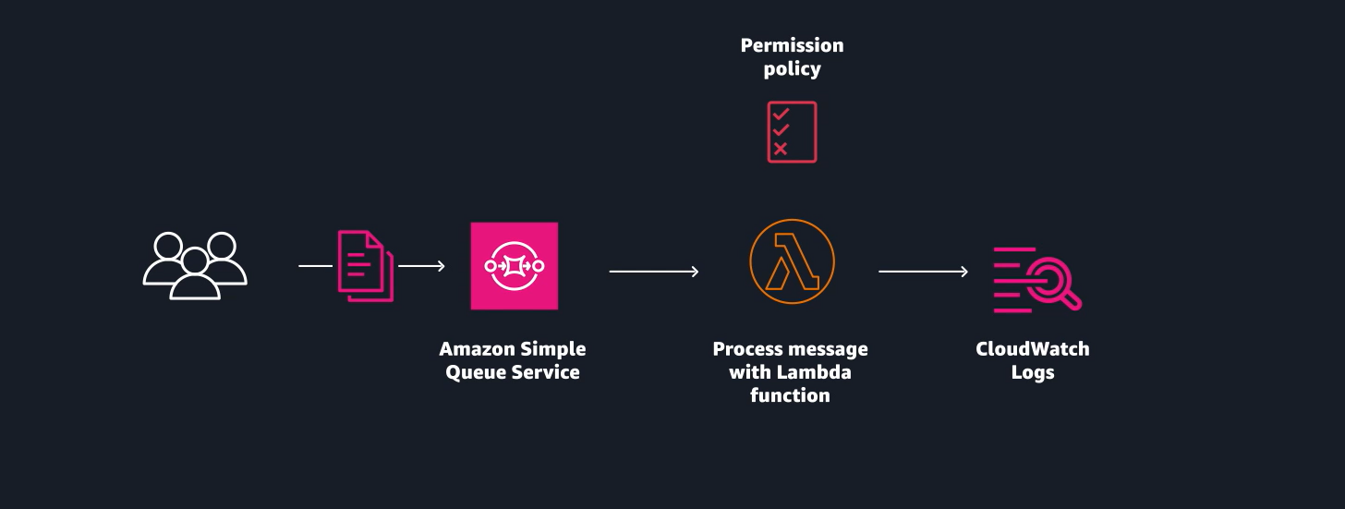
Lab Time
Set up a serverless event-driven architecture using:
Amazon SQS (Simple Queue Service):
Used to hold messages sent by producers until they’re processed.
AWS Lambda Function ("Lambert"):
Automatically triggered when messages are added to the SQS queue. It reads, logs, and processes them.

Slide 22
Containers and Orchestration on AWS

Slide 23
In this lesson, you will learn:
Describe how containers create a consistent and portable runtime environment across different systems.
Explain how Amazon Elastic Container Registry (Amazon ECR) is used to store, manage, and version container images.
Identify how Amazon ECS and Amazon EKS orchestrate containers to deploy, scale, and manage applications.
Describe how AWS Fargate runs containers without the need to provision or manage servers.

Slide 24
Containers
Containers provide a reliable way to package your application’s code and dependencies into a single, portable unit, making them ideal for workflows that require high security, reliability, and scalability.
Why Containers?
  Solve the "works on my machine" problem
  Faster startup and better resource efficiency
  Isolation for improved reliability

Slide 25
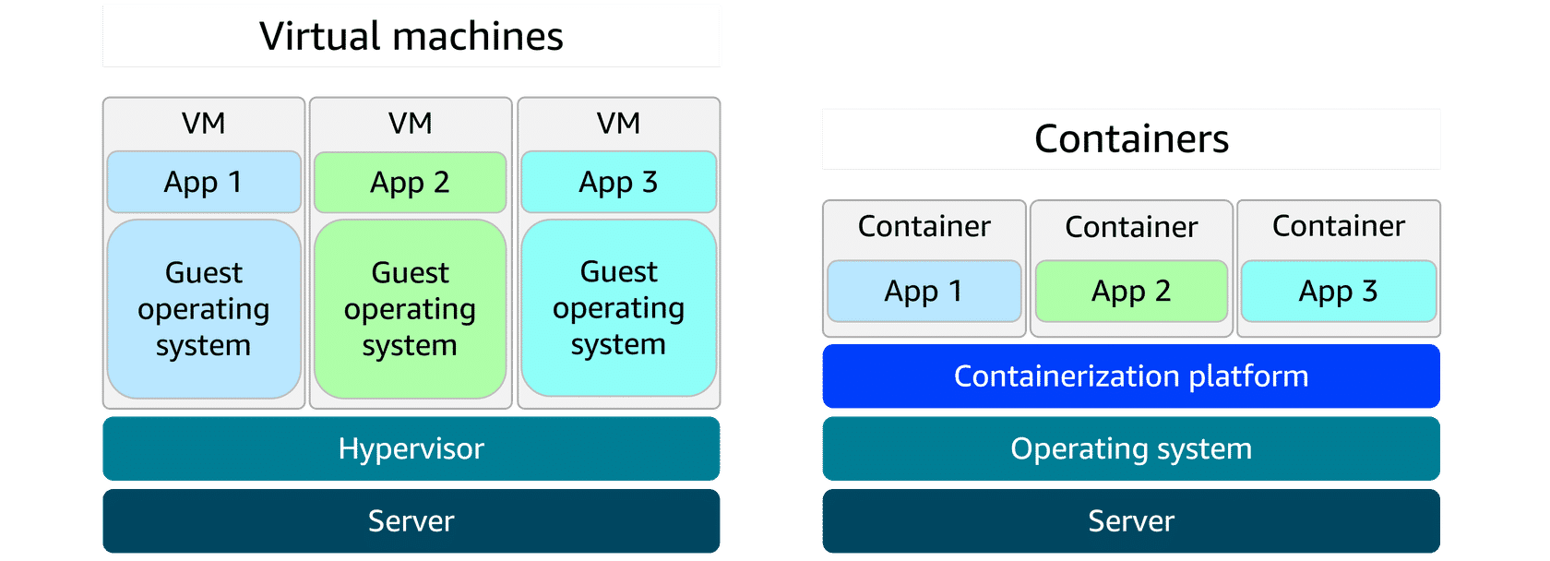
Containers and VMs
A container packages your application with everything it needs to run, so it works the same on any computer.
This helps to move, update, and manage.
Containers are faster and lighter than virtual machines (VMs) because they share the host computer’s operating system.
VMs use a hypervisor to run full, separate operating systems, which makes them less resource-efficient and have longer startup times.

Slide 26
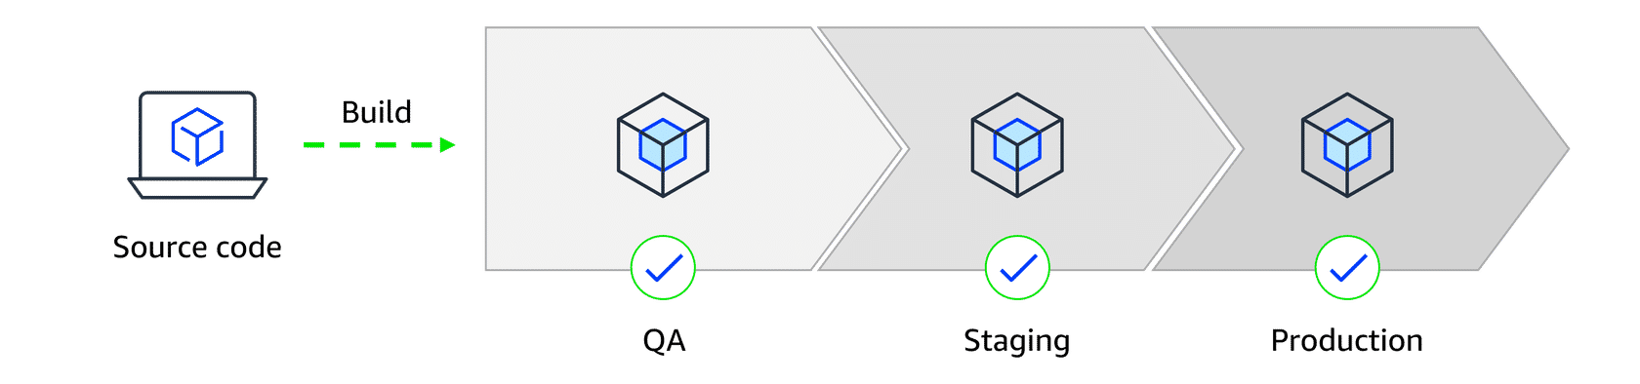
Deployment consistency with containers
When a developer’s environment differs from staging or production, deployments can fail and become difficult to debug.
Containers solve this by keeping the application’s environment consistent everywhere, making deployments smoother and assisting troubleshooting.

Slide 27
Scaling containers with orchestration
As containerized applications scale, managing them becomes more complex.
A setup that began with a few containers on a single host can quickly grow into hundreds or thousands of containers across multiple hosts.
At that scale, manually handling container lifecycle, monitoring, and general operations becomes unsustainable.
This is where orchestration tools come in.
They automate deployment, scaling, and management to keep everything running smoothly.

Slide 28
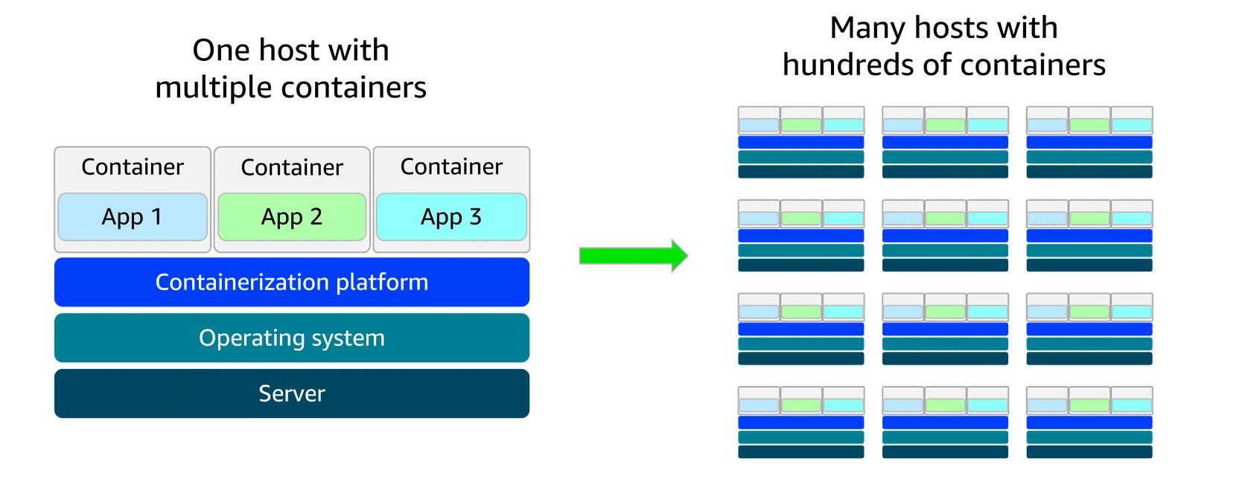

Slide 29
AWS Container Building Blocks
1. Amazon ECR
  Secure, fully managed container image storage.
2. Orchestration Services
  Amazon ECS – AWS-native, simplified container orchestration.
  Amazon EKS – Managed Kubernetes with full flexibility and control.
3. Compute Options
  Amazon EC2 – Full control over infrastructure.
  AWS Fargate – Serverless, AWS manages the underlying servers.

Slide 30
How It Fits Together
Build and store container images in ECR
Deploy using ECS or EKS
Run containers on EC2 or Fargate

Slide 31
AWS container services
AWS has a set of tools for managing containers that fits into three categories: orchestration, registry, and compute.

Slide 32
Amazon ECS
Amazon Elastic Container Service (Amazon ECS) is a scalable container orchestration service for running and managing containers on AWS, like Docker containers.
Docker is a software platform for building, testing, and deploying applications quickly.

Slide 33
Amazon ECS launch types
Amazon ECS with Amazon EC2
  Is ideal for small-to-medium businesses that need full control over infrastructure.
  Suitable for custom applications requiring specific hardware or networking configurations, with the flexibility of Amazon EC2 and the simplicity of Amazon ECS.
Amazon ECS with AWS Fargate
  Is perfect for startups or small teams building web applications with variable traffic.
  It's a serverless option—no server management required—so teams can focus on development while Amazon ECS handles scaling and orchestration.

Slide 34
Amazon EKS
Amazon Elastic Kubernetes Service (Amazon EKS) is a fully managed service for running Kubernetes on AWS.
It simplifies deploying, managing, and scaling containerized applications using open-source Kubernetes, with ongoing support and updates from the broader community.

Slide 35
Amazon EKS launch types
Amazon EKS with Amazon EC2:
  This is best for enterprises needing full control over infrastructure.
  It offers deep customization of EC2 instances alongside Kubernetes scalability—ideal for complex, large-scale workloads.
Amazon EKS with AWS Fargate:
  This is great for teams wanting Kubernetes flexibility without managing servers.
  It combines Kubernetes power with serverless simplicity, helping to scale applications quickly across various use cases.

Slide 36
Amazon ECR
Amazon Elastic Container Registry (Amazon ECR) is where you can store, manage, and deploy container images.
It supports container images that follow the Open Container Initiative (OCI) standards.
You can push, pull, and manage images in your Amazon ECR repositories using standard container tooling and command line interfaces (CLIs).

Slide 37
Fargate
AWS Fargate is a serverless compute engine for containers.
It works with both Amazon ECS and Amazon EKS.
Fargate is a container hosting platform, unlike Amazon ECS and Amazon EKS, which are both container orchestration services.
When using Fargate, you do not need to provision or manage servers.
Fargate manages your server infrastructure for you.
You can focus more on innovating and developing your applications, and you pay only for the resources that are required to run your containers.

Slide 38
Additional Compute Services

Slide 39
In this lesson, you will learn:
Describe how Elastic Beanstalk streamlines environment provisioning and management.
Explain how AWS Batch manages large-scale computing tasks and automatically adjusts resources based on demand.
Identify how Amazon Lightsail streamlines web application setup and management without the need for complex infrastructure.
Describe how AWS Outposts extends AWS services to on-premises environments, supporting hybrid cloud architectures.

Slide 40
Elastic Beanstalk
Elastic Beanstalk is a fully managed service that streamlines the deployment, management, and scaling of web applications.
Developers can upload their code, and Elastic Beanstalk automatically handles the provisioning of infrastructure, scaling, load balancing, and application health monitoring.
It supports various programming languages and frameworks, such as Java, .NET, Python, Node.js, Docker, and more.
It provides full control over the underlying AWS resources while automating many operational tasks.
Good for: Deploying and managing web applications, RESTful APIs, mobile backend services, and microservices architectures, with automated scaling and simplified infrastructure management

Slide 41
AWS Batch
AWS Batch is a fully managed service that you can use to run batch computing workloads on AWS.
It automatically schedules, manages, and scales compute resources for batch jobs, optimizing resource allocation based on job requirements.
Ideal for compute-heavy workloads.
Good for: Processing large-scale, parallel workloads in areas like scientific computing, financial risk analysis, media transcoding, big data processing, machine learning training, and genomics research

Slide 42
Lightsail
Amazon Lightsail is a cloud service offering virtual private servers (VPSs), storage, databases, and networking at a predictable monthly price.
It’s ideal for small businesses, basic workloads, and developers seeking a straightforward AWS experience without the complexity of the full AWS Management Console.
Good for: Basic web applications, low-traffic websites, development and testing environments, small business websites, blogs, and learning cloud services

Slide 43
Outposts
AWS Outposts is a fully managed hybrid cloud solution that extends AWS infrastructure and services to on-premises data centers.
It provides a consistent experience between on premises and the AWS Cloud, offering compute, storage, and networking components.
Good for: Low-latency applications, data processing in remote locations, migrating and modernizing legacy applications, and meeting regulatory compliance or data residency requirements

Slide 44
Recap
This module gave you a practical understanding of AWS compute services, so you can choose the right tools for your applications.
You learned when to use fully managed options like Lambda or Fargate, and when full control with Amazon EC2 made sense.
You explored how containers solve deployment consistency issues and how AWS services, like Amazon ECS and Amazon EKS, simplify managing and scaling containerized applications.
You also discovered services like Elastic Beanstalk, AWS Batch, Lightsail, and Outposts, and how each supported specific use cases, from basic web hosting to large-scale batch processing or hybrid cloud environments.

Slide 45
Resources
Resource link | Description
Containers on AWS | The AWS Containers Services page provides an overview of the AWS container offerings, including services for container image storage, orchestration, and compute. These offerings are designed to streamline the deployment and management of containerized applications.
Amazon Elastic Container Registry | The Amazon ECR is a fully managed service for storing, managing, and deploying container images securely at scale.
Amazon Elastic Container Service | Amazon ECS is a fully managed service that streamlines the deployment, management, and scaling of containerized applications on AWS.
Amazon Elastic Kubernetes Service | Amazon EKS is a fully managed Kubernetes service that streamlines running Kubernetes clusters on AWS and on premises. It automates infrastructure management and integrates with AWS networking, security, and storage services.
AWS Fargate | Fargate is a serverless compute engine for running containers without managing servers. It is integrated with Amazon ECS and Amazon EKS.
AWS Elastic Beanstalk | Elastic Beanstalk is a fully managed service for deploying and scaling web applications without managing infrastructure.
AWS Batch | AWS Batch is a fully managed service for efficiently running large-scale batch computing jobs on AWS.
What is Amazon Lightsail? | Lightsail is a simplified cloud platform offering VPS, containers, and databases with predictable pricing.
What is AWS Outposts? | AWS Outposts extends AWS infrastructure and services to on-premises locations for low-latency, local data processing.
Choosing a modern application strategy | The AWS Decision Guide for Modern Application Strategy helps organizations determine the most suitable development approach—serverless or Kubernetes—based on their operational model, team structure, and workload requirements.

